Slide 1
Support tickets– Siebel and Click tools

Slide 2
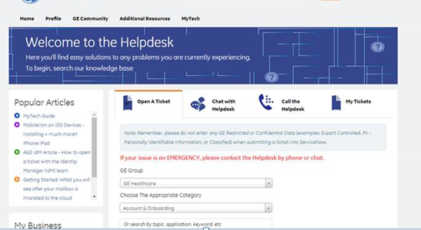
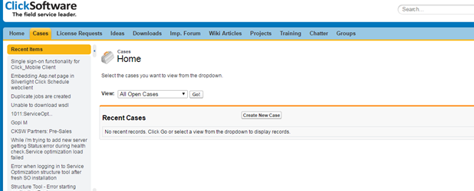
Support through other teams
Siebel – ServiceNow
https://ge.service-now.com/Helpdesk/
htthttps://ge./
ClickSoftware – Support tool
support.Clicksoftware.com

Slide 3
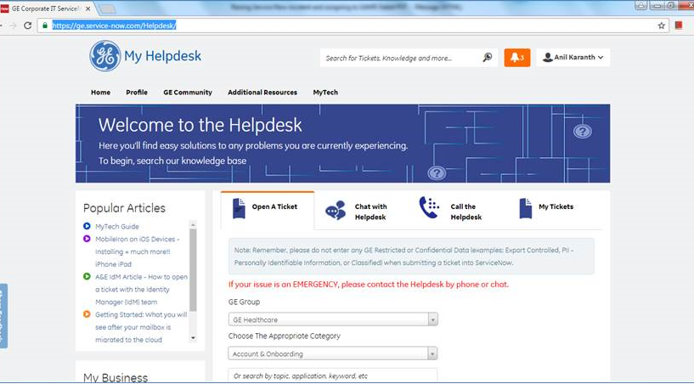
Siebel team Support
Go to https://ge.service-now.com/Helpdesk/

Slide 4
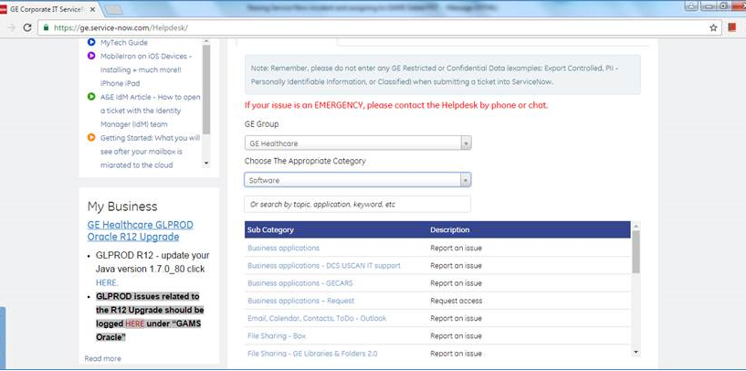
Siebel team Support
Choose Category as Software and select Sub category as Business applications

Slide 5
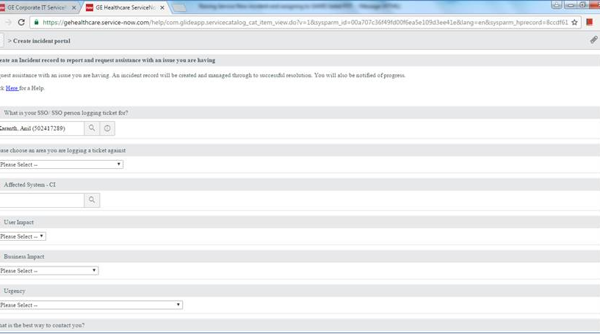
Siebel team Support
A new form will open

Slide 6
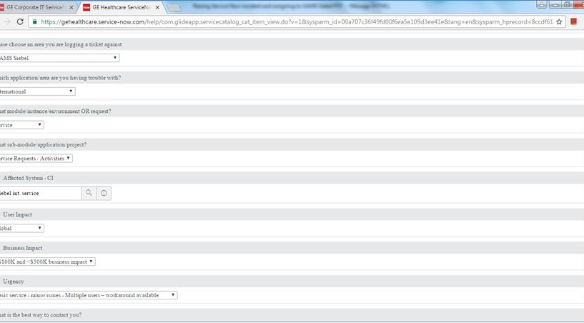


Siebel team Support
Select the details as per the below snapshot

Slide 7
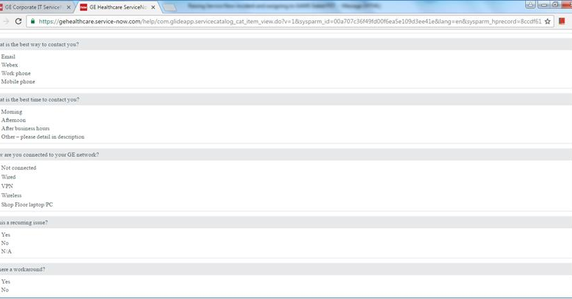
Siebel team Support

Slide 8
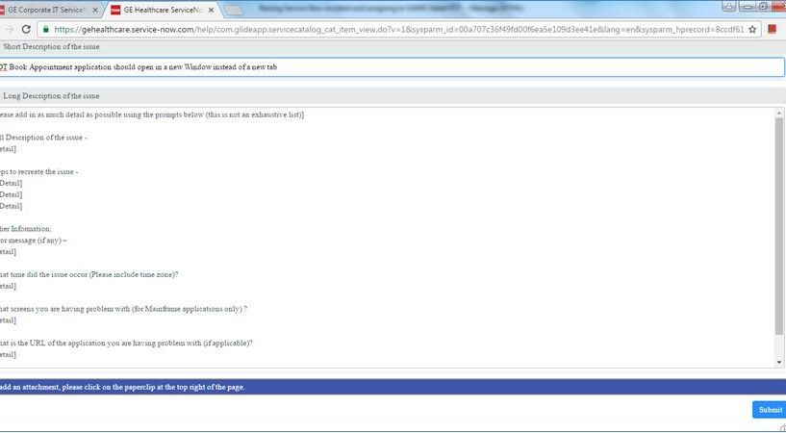


Siebel team Support

Slide 9
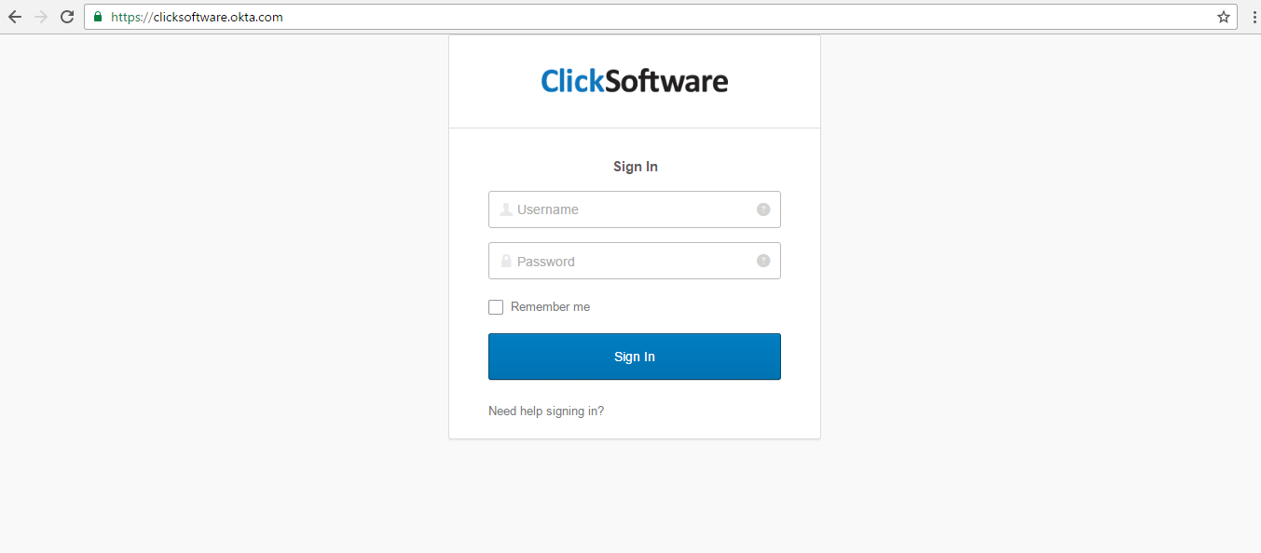
Click Team support
Login Page of Click support portal

Slide 10
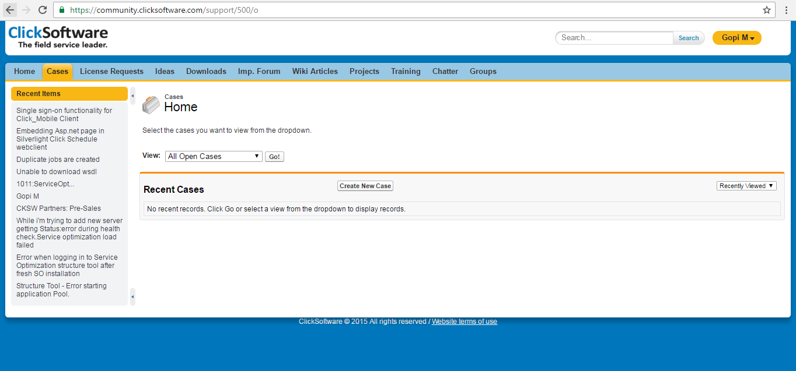
Click Team support
Raising new cases

Slide 11
Thank You

